Slide 1
Quantitative Methods for Data Analysis
Tim Wood

Slide 2
Approaches to Data
Raw data can oftentimes be hard to interpret or give misleading results.
Data range - For expression data we usually log transform, because expression data ranges are HUGE (we consider them to be in exponential space). And log2(2^x) = x. Running any sort of linear analysis on exponential data is a no-go.
Huge dimensionality - in our case, we have a single experiment with 100k+ genes. In data science world, a single experiment is called a sample or observation, and the 100k+ axis is called the features or dimensions. Hence our data set’s size is S x F (samples x features).
Error on data - It’s important to know if our data has been normalized to reduce error. TPM/FKPM are examples of this in RNA-seq data. In fact, I couldn’t tell you what FKPM is personally, but just know that this is most commonly used.
Artifacts - slightly different from errors on data in my opinion. An artifact is more like effects that are procedurally generated from some imperfect protocol, producing downstream results that might have a strong signal. Teasing apart artifacts from real results requires comprehensive knowledge of all of the methods used in the pipeline

Slide 3
Supervised vs Unsupervised Methodologies
In general, three major classes exist in machine learning world:
Supervised learning - When all of your data points are labelled
Semi-Supervised learning - When some of your data points are labelled
Unsupervised learning - When none of your data points are labelled
Examples:
Supervised - We wish to build a model given a set of images all labelled as “Dog” or “Cat”.
Semi Supervised - We wish to build a model given a set of images, with some labelled as “Dog” or “Cat”, and some not labelled at all.
Unsupervised - We wish to build a model given a set of images, none of which are labelled.

Slide 4
Key points
Notice - the existence of a label says nothing about the actual data. We can have unlabelled images, or labelled images. The remarkable thing about us as humans is we can identify a “Dog” only by seeing very few examples of what a dog actually is.
So, given a data set, what can we train a machine to learn?

Slide 5
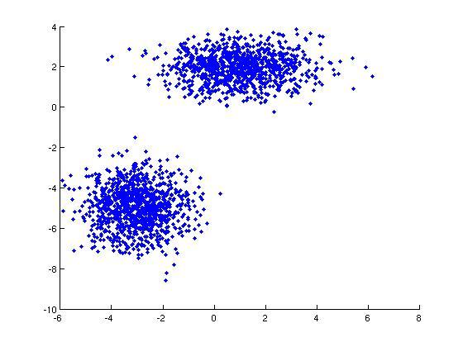
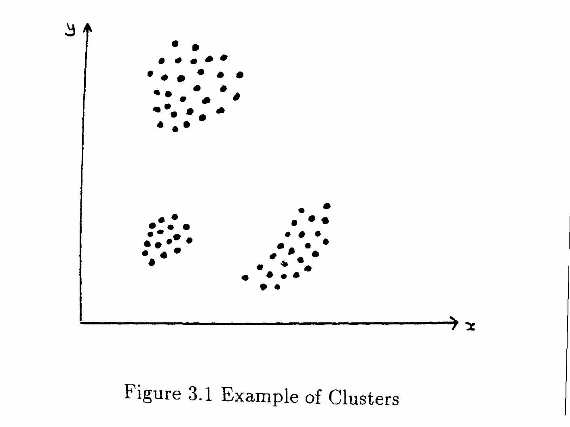
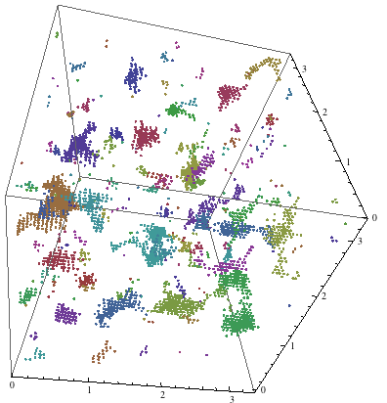
Clustering
From an abstract view, the concept of clustering is pretty simple.
Images from Google Images

Slide 6
Clustering
But from a computational point of view, how do we define this?
Additionally, clustering is entirely dependent on our data (obviously). So any transformations we do, almost certainly have an effect on clustering. See dataTransformations.pdf
Clustering is generally considered to be unsupervised, except in cases where you have some labelled data.

Slide 7
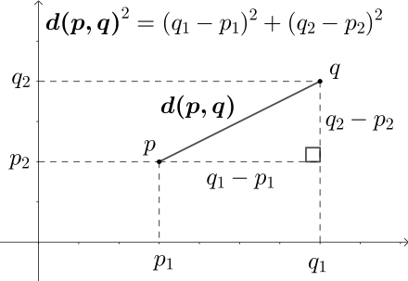
Clustering - A distance metric
So we now approach the idea of what is a cluster? To do this, we need to define relationships between points…
A natural starting place is “distance”.
Euclidean is one example -
Stems from Pythagorean Theorem: A^2 + B^2 = C^2
Equation for euclidean distance in N dimensions:
Intuitive check: If we have the same point, is the distance zero given this equation? Let’s check!
https://en.wikipedia.org/wiki/Euclidean_distance

Slide 8
Distance - Example case Euclidean
Interpretability note: The subscripts on p and q, i.e., p₁ means the 1st feature of point p. So in the example on the left, X₂ = 9
Let’s say we have 2 points both in 5-d space.
X = <1,9,0,0,4>
Y = <1,9,0,0,4>
We plug in the numbers to the equation given:
d(X,Y) = sqrt( (1-1)^2 + (9-9)^2 + (0-0)^2 + (0-0)^2 + (4-4)^2 )
d(X,Y) = sqrt(0) = 0

Slide 9
Other distance examples
Manhattan (city block) distance: The distance from point X to point Y if you can only move horizontally and vertically.
Pearson distance: 1-(pearson r). Therefore things that are perfectly correlated have distance 0, and things that are perfectly anti correlated have distance 2 (1-(-1)).
“Chessboard distance”
https://homepages.inf.ed.ac.uk/rbf/HIPR2/metric.htm
And a new one I just invented: CHB distance - the distance in Chiquita bananas from point X to Y in 3D space.

Slide 10
Objectives
In order to actually cluster, we have to optimize an objective function. Sometimes, there is a deterministic algorithm for clustering (hierarchical, knn). Other times, we have a non-deterministic algorithm (EM, kmeans).
Non deterministic algorithms arise because we have random initializations. We iterate through the algorithm until some convergence criteria is met (when do we stop?)
Deterministic algorithms arise when we have a defined metric and just apply the rules to the data.

Slide 11

KMeans
Given a set of observations (x₁, x₂, …, x_{n}), where each observation is a d-dimensional real vector, k-means clustering aims to partition the n observations into k (≤ n) sets S = {S₁, S₂, …, S_{k}} so as to minimize the within-cluster sum of squares
Read the above equation as follows:
Find an optimal S, the number of clusters, such that the sum of the distances between each point and it’s assigned clusters’ mean is minimized.
Even easier conceptual language:
Find means such that distance is generally minimized between means and points in that cluster.
https://en.wikipedia.org/wiki/K-means_clustering

Slide 12
KMeans - Unsupervised learning
Example with SmoothDraw time!

Slide 13
Expectation-Maximization (EM) Algorithm - Unsupervised learning
Not going to add math here. But here’s how you think of EM algorithm:
Instead of fitting k number of means to our data, we fit k number of gaussian distributions. Instead of optimizing just k number of means, you optimize k number of means and standard deviations.
EM really is just kmeans spiced up - kmeans assumes a uniform distribution around the mean.
EM algorithm is the main algorithm behind the RSEM¹ transcript quantification algorithm
(gif broken in downloaded ppt, visit Wikipedia page to see)
[2]
1 - Li, Bo, and Colin N. Dewey. "RSEM: accurate transcript quantification from RNA-Seq data with or without a reference genome." BMC bioinformatics 12.1 (2011): 323.
2 - https://en.wikipedia.org/wiki/Expectation%E2%80%93maximization_algorithm

Slide 14
Hard vs Soft clustering
As you can see in kmeans, a sample gets assigned to the closest mean. Therefore, each sample can only be a part of 1 cluster.
But in EM, since we have distributions, each sample has a probability of being in a certain cluster. Since normal distributions never have a probability of zero for any value of X, each point is a part of each cluster even if a very small amount! Intuitively this says that each point could have been generated from any of the clusters, albeit some very very … very unlikely!

Slide 15
Hierarchical Clustering (HC) - Unsupervised learning
Both KMeans and EM were non-deterministic, iterative algorithms coupled with some convergence termination criteria.
Now an example of a deterministic algorithm. It doesn’t matter how many times you run this algorithm on your data set - the answer will always be the same.
For now, we will focus solely on hierarchical agglomerative clustering. The algorithm is as follows:
Start with N clusters - Each data point is in their own cluster
Until all data points are in a single cluster, do:
Merge two closest clusters
Update tree
Cut tree at desired height for some given k number of clusters.
Example with SmoothDraw time!

Slide 16
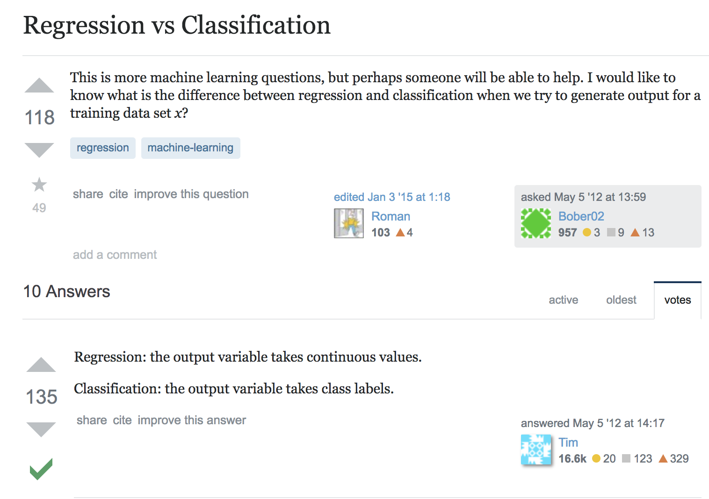
It was totally funny to me that I stumbled upon this looking for a source to quote… This isn’t me, though.

Slide 17
Classification - Supervised learning (mostly)
Task: Given a set of observations or samples, S, and a set of discrete targets, T, construct a model that accurately maps S->T.
That’s pretty vague, and that’s why there are a lot of different methods to answer this question. We now venture into an area that we throw around words like “Neural network”, “Random forest”, “Support Vector Machines”, etc.
For now, we will focus on Random forests and how they can be utilized for classification and regression.
The main idea of Classification is that we have discrete targets - i.e., sample S is in class 1, or 2, or 3, or 4, … etc.

Slide 18
Regression - Brief intro
In regression, we want to predict a continuous value. Let’s go over linear regression….

Slide 19
Linear Regression
In linear regression, our main assumption is that our data behaves in a linear model. This means that our dependent variable, Y, can be described by our independent variable, X, in a linear formula based on the features of X.
This is no different than our 7th grade teachings of what it means to be a linear line:
The first equation is just equation 2, in p-dimensional space. Each feature has a beta associated with it. The first term, B_0*1 is just alpha in the second equation.

Slide 20
Linear Regression
Given a bunch of points, imagine we could construct a linear line in N-d space that was a “good fit”. Then, it would be easy to predict future points! We would just plug in our new data point, X, into to our equation.
There’s no trick here - we are literally just trying to predict what the Y value will be at some unseen X value.
But how do we actually do this?

Slide 21
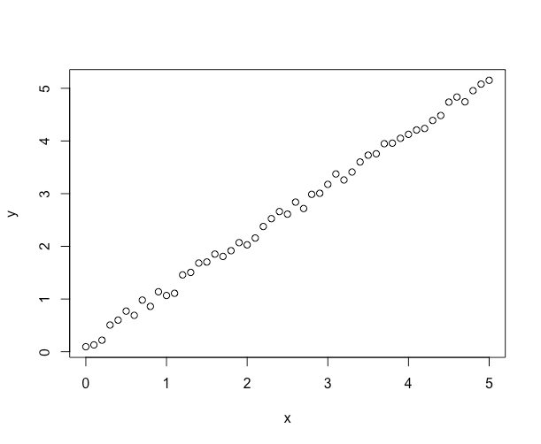
You try...
Tell me your guess for parameters 𝝰 and 𝞫 given y = 𝞫x + 𝝰

Slide 22

Linear Regression - What are we actually doing?
Remember : In a linear model, y = mx+b. We can rearrange this then:
y = 𝝰 + 𝞫x
Formally, our linear fit will be defined as follows:

Slide 23
Linear Regression - Intuition
All the equation on the last slide is saying is this:
Find the 𝛂 and 𝞫 such that the sum of all the distances of point i to the line is minimized.
In even simpler terms: Fit a line in linear space that is really close to each point.
Don’t even worry about how to solve stuff like this. Just know what is happening!

Slide 24
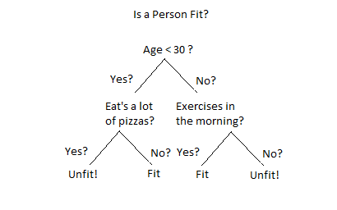
Decision Trees - Classification
Perhaps the most basic form of a classifier is a decision tree.
Don’t worry about how to make one of these for now. Just assume you have access to a bunch of fancy math that will compute this for you.
Given the tree on the right, and 3 metrics (Age, Pizzas, Exercise), we could classify a person as Unfit or Fit.

Slide 25
Random Forests
Random forests are literally just a bunch of decision trees. The difference is, in order to try to prevent overtraining (your model memorizing your training data), each tree in the forest is subject to the following constraints:
Each tree can only observe a random X% (usually 70%) of the samples.
Each split that occurs in a tree is based on only F* (usually sqrt(F)) number of features.
The logic behind this is that each tree only observes a subset of the data, and at each decision only observes a subset of the feature space. Any one given tree will likely be weak - but if we combine them together, we get a strong consensus model.
Classification is then done through a consensus model of the trees - The majority vote at the end.
Therefore if a Random Forest contains 500 trees, and there are 2 classes (i.e. the RF must choose class 1 or 2 as output), any sample that receives 251 votes or more for some class C will be assigned to C.

Slide 26

https://medium.com/@williamkoehrsen/random-forest-simple-explanation-377895a60d2d

Slide 27
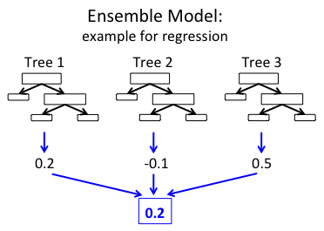
Random Forests - Regression
Random forests that perform regression have the same concept as a classification RF, except each tree now instead outputs a continuous value. So, we can do something like take the average of each tree as our final forest output.

Slide 28
Relating all of this to the Dimensions Set
Recall what we have: For each experiment (a sample), we have: Some features (gene expression), and a label (“Winningness”). Chuck and I toyed with an idea of two types of labels - Perhaps we want to define it as a binary variable “Win/Loss”, or perhaps a continuous variable, a scale from 0 to 1 of the degree of winning or something like that. Maybe 0 is neither wins, 0.5 is one wins, 1 is both wins. Who knows. Can think of any type of metric to express this.
If our label was binary, Win/Lose, what type of predictive model would we be building (Classifier or Regressor)?
We can explore clustering methods for genes across all monocultures.
Proper data format? What will be in our data matrix?
We always cluster observations, in this case our observations will be genes. So we will have a Gene x Monoculture data matrix? What about time points?
Things that we would love to see! ...
Gene clusters that have a functional basis
Gene clusters that have an evolutionary basis
Gene clusters that are powerful predictors of Winning/Losing
What I personally did, with the Random Forest stuff, was I took our data and trained a RF classifier. The labels were simplified - I only looked at a specific species’ Win/Loss classification across Bicultures. To be honest the analysis was pretty weak, and I am planning to go back to it. Maybe after we wrap up some Monoculture analysis, though.

Slide 29
Still up … NMF, Dimensionality reduction (PCA, tSNE)
Let’s reconvene at a future date?

